Slide 1
Chapter
2
Global E-business and Collaboration
Notes:
There are two video cases available for this chapter:
Case 1: Walmart’s Retail Link Supply Chain
Case 2: CEMEX - Becoming a Social Business

Slide 2
Essentials of Management Information Systems
Chapter 2 Global E-Business and Collaboration
STUDENT LEARNING OBJECTIVES
What major features of a business are important for understanding the role of information systems?
How do systems serve different management groups in a business and how do systems that link the enterprise improve organizational performance?
Notes:
You might start the class discussion with a question to students asking them to talk about how they have used computers on the job. Alternatively, if few have a work history, ask about how they are using computers in their social lives, or student lives. Can they imagine life without computers and systems?

Slide 3
Essentials of Management Information Systems
Chapter 2 Global E-Business and Collaboration
STUDENT LEARNING OBJECTIVES
Why are systems for collaboration and teamwork so important and what technologies do they use?
What is the role of the information system’s function in a business?

Slide 4
Essentials of Management Information Systems
Chapter 2 Global E-Business and Collaboration
VIDEO CASES AND LEARNING TRACKS
Learning Tracks
Systems from a Functional Perspective
IT Enables Collaboration and Teamwork
Challenges of Using Business Information Systems
Organizing the Information Systems Function
Video Cases
Case 1: Walmart’s Retail Link Supply Chain
Case 2: CEMEX – Becoming a Social Business
Instructional Video 1: US Foodservice Grows Market with Oracle CRM on Demand

Slide 5
Essentials of Management Information Systems
Chapter 2 Global E-Business and Collaboration
Social Business at BASF
Problem: The challenges of managing a far-flung global enterprise.
Solutions: Use social technology as a platform to solve the challenges.

Slide 6
Essentials of Management Information Systems
Chapter 2 Global E-Business and Collaboration
Social Business at BASF
Connect.BASF provided enterprise-wide social networking platform to share knowledge, collaborate, and encourage employees and managers to discuss their work.
Demonstrates IT’s role in collaboration and improving the flow of knowledge
Illustrates the ability of information systems to improve an organization’s ability to innovate, execute, and grow profits.
Notes:
Ask students what advantages online learning provides over in-class learning. In a corporate setting, are there any benefits to in-class learning? What are the other benefits, besides employee learning, to the new SharePoint technologies and tools created?

Slide 7
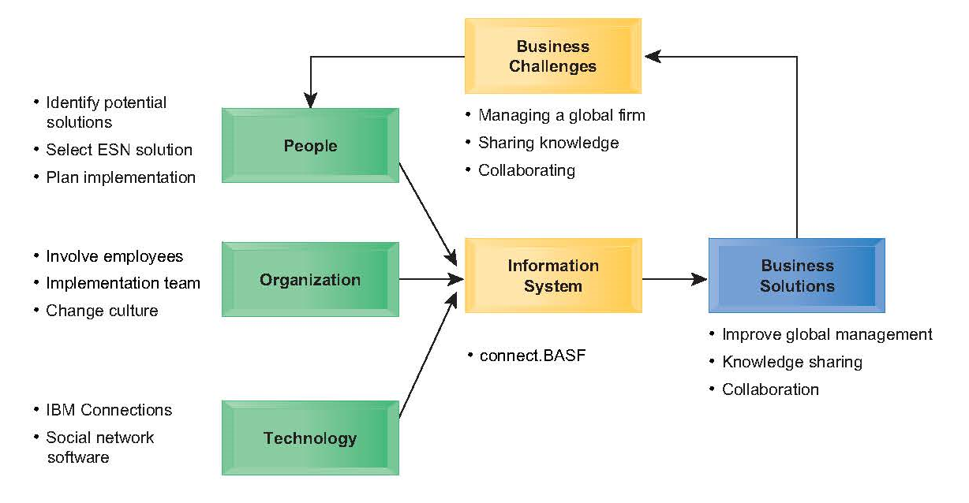
Essentials of Management Information Systems
Chapter 2 Global E-Business and Collaboration
Social Business at BASF

Slide 8
Essentials of Management Information Systems
Chapter 2 Global E-Business and Collaboration
Major Features of a Business
Business: formal organization that makes products or provides a service in order to make a profit
Organizing a Business: Basic Business Functions
Four basic business functions
  Manufacturing and production
  Sales and marketing
  Finance and accounting
  Human resources
Notes:
Emphasize each element in the definition of “business”. What is meant by “formal organization”? Formal organizations get to be “formal” in part because they are chartered by the nation state (a country’s legal system). As a result, they have certain powers and obligations to perform. How might businesses differ depending on whether they make products or provide services? What role does profit play in business?

Slide 9
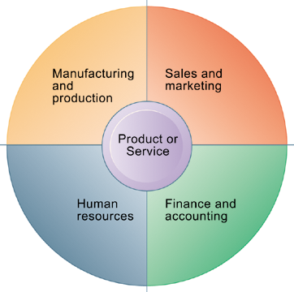
Essentials of Management Information Systems
Chapter 2 Global E-Business and Collaboration
What major features of a business are important for understanding the role of information systems?
The Four Major Functions of a Business
Every business, regardless of its size, must perform four functions to succeed. It must produce the product or service; market and sell the product; keep track of accounting and financial transactions; and perform basic human resources tasks, such as hiring and retaining employees.
Figure 2.1
Notes:
Emphasize that each function is critical to any business, and explain that the product or service is at the center of the diagram because it “governs” the way each business approaches the four major business functions.

Slide 10
Essentials of Management Information Systems
Chapter 2 Global E-Business and Collaboration
What major features of a business are important for understanding the role of information systems?
Five Basic Business Entities
Suppliers
Customers
Employees
Invoices/payments
Products and services
Notes:
You can describe any business in terms of these five elements. Ask a student who has work experience to describe the business entities as his/her current place of work.

Slide 11
Essentials of Management Information Systems
Chapter 2 Global E-Business and Collaboration
What major features of a business are important for understanding the role of information systems?
Business Processes
Logically related set of tasks that define how specific business tasks are performed
  The tasks each employee performs, in what order, and on what schedule
  E.g., Steps in hiring an employee
Some processes tied to functional area
  Sales and marketing: identifying customers
Some processes are cross-functional
  Fulfilling customer order
Notes:
Ask students to describe some example business processes based on their personal work experiences. Examples might include assembling a product, identifying customers, paying creditors, or hiring employees.

Slide 12
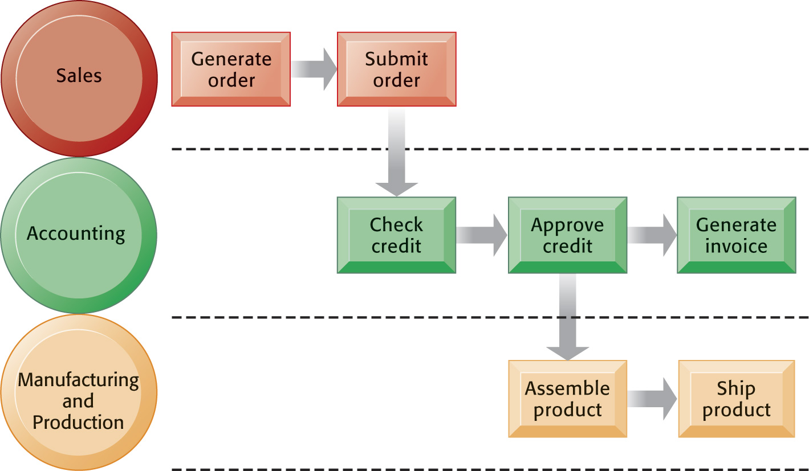
Essentials of Management Information Systems
Chapter 2 Global E-Business and Collaboration
What major features of a business are important for understanding the role of information systems?
The Order Fulfillment Process
Fulfilling a customer order involves a complex set of steps that requires the close coordination of the sales, accounting, and manufacturing functions.
Figure 2.2
Notes:
Emphasize that each rectangle represents one part of the larger business process of order fulfillment. Notice that this business process spans more than one type mentioned on the previous slide.

Slide 13
Essentials of Management Information Systems
Chapter 2 Global E-Business and Collaboration
What major features of a business are important for understanding the role of information systems?
How IT Enhances Business Processes
Automation of manual processes
Change the flow of information
Replace sequential processes with simultaneous activity
Transform how a business works
Drive new business models
Notes:
Ask students for examples for how IT is used in automation, changing information flow, replacing sequential processes, business transformation, and driving new business models.

Slide 14
Essentials of Management Information Systems
Chapter 2 Global E-Business and Collaboration
What major features of a business are important for understanding the role of information systems?
Managing a Business and Firm Hierarchies
Firms coordinate work of employees by developing hierarchy in which authority is concentrated at top.
  Senior management
  Middle management
  Operational management
  Knowledge workers
  Data workers
  Production or service workers
Each group has different needs for information.
Notes:
Ask students what types of information are pertinent to each level of the hierarchy. Senior managers need summary information that can quickly inform them about the overall performance of the firm; middle managers need more specific information on the results of specific functional areas of the firm; and so on.

Slide 15
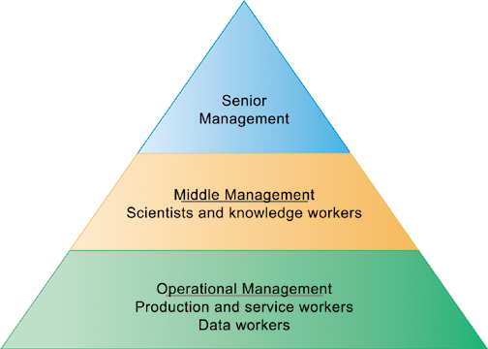
Essentials of Management Information Systems
Chapter 2 Global E-Business and Collaboration
What major features of a business are important for understanding the role of information systems?
Levels in a Firm
Business organizations are hierarchies consisting of three principal levels: senior management, middle management, and operational management. Information systems serve each of these levels. Scientists and knowledge workers often work with middle management.
Figure 2.3
Notes:
Emphasize to students that different information systems are used by different levels of the pyramid.

Slide 16
Essentials of Management Information Systems
Chapter 2 Global E-Business and Collaboration
What major features of a business are important for understanding the role of information systems?
The Business Environment
Global environment factors
  Technology and science
  Economy
  Politics
  International change
Immediate environment factors
  Customers
  Suppliers
  Competitors
  Regulations
  Stockholders
Notes:
Ask students to give examples of how factors like politics and international change affect business based on their own experiences. One obvious example is political disruption in the Middle East and its impact on oil and gas prices around the world.

Slide 17
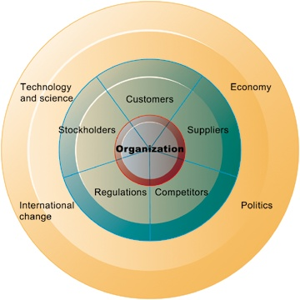
Essentials of Management Information Systems
Chapter 2 Global E-Business and Collaboration
What major features of a business are important for understanding the role of information systems?
The Business Environment
To be successful, an organization must constantly monitor and respond to—or even anticipate—developments in its environment. A firm’s environment includes specific groups with which the business must deal directly, such as customers, suppliers, and competitors as well as the broader general environment, including socioeconomic trends, political conditions, technological innovations, and global events.
Figure 2.4
Notes:
Emphasize to students that the outer ring consists of factors which are not a part of businesses and organizations, but nevertheless have a significant impact on the way a business is run and how well it performs. Obviously, the health of the larger economy effects businesses. How does development in technology and science impact business?

Slide 18
Essentials of Management Information Systems
Chapter 2 Global E-Business and Collaboration
What major features of a business are important for understanding the role of information systems?
The Role of Information Systems in a Business
Firms invest in information systems in order to:
  Achieve operational excellence.
  Develop new products and services.
  Attain customer intimacy and service.
  Improve decision making.
  Promote competitive advantage.
  Ensure survival.
Notes:
To accomplish business objectives, businesses develop and use information systems.

Slide 19
Essentials of Management Information Systems
Chapter 2 Global E-Business and Collaboration
How do systems serve managers and and improve organizational performance?
Systems for Different Management Groups
Transaction processing systems (TPS)
  Keep track of basic activities and transactions of organization
Systems for business intelligence
  Address decision-making needs of all levels of management
    Management information systems (MIS)
    Decision support systems (DSS)
    Executive support systems (ESS)
Notes:
The constituency perspective emphasizes which groups in the firm are served by specific systems.

Slide 20
Essentials of Management Information Systems
Chapter 2 Global E-Business and Collaboration
How do systems serve managers and and improve organizational performance?
Transaction processing systems:
  Serve operational managers.
  Principal purpose is to answer routine questions and to track the flow of transactions through the organization.
    E.g., inventory questions, granting credit to customer
  Monitor status of internal operations and firm’s relationship with external environment.
  Major producers of information for other systems.
  Highly central to business operations and functioning.
Notes:
TPS systems are really the most basic kind of information system in a business, and they were among the first to be developed. A business is in large part a collection of transactions. Keeping track of all these transactions is the fundamental job of management. Without this, the business would soon collapse. Ask students for examples of a “transaction” in a business and make sure they understand the fundamental role of transactions.

Slide 21
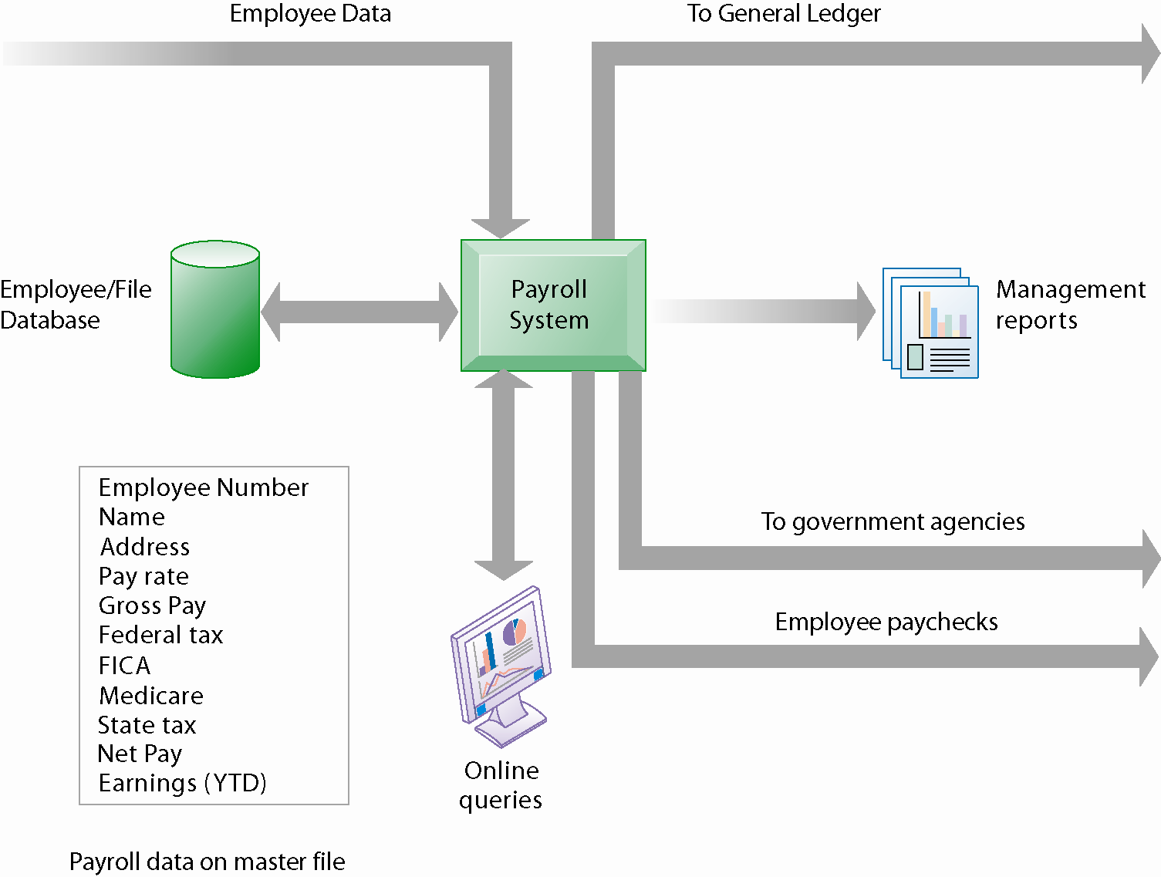
Essentials of Management Information Systems
Chapter 2 Global E-Business and Collaboration
How do systems serve managers and and improve organizational performance?
A Payroll TPS
A TPS for payroll processing captures employee payment transaction data (such as a timecard). System outputs include online and hard copy reports for management and employee paychecks.
Figure 2.5
Notes:
A payroll system involves a transaction between the firm and its employees. Without such a system, no paychecks are sent. That’s pretty basic!

Slide 22
Essentials of Management Information Systems
Chapter 2 Global E-Business and Collaboration
How do systems serve managers and and improve organizational performance?
Management information systems:
  Provide middle managers with reports on firm’s performance, to help monitor firm and predict future performance.
  Summarize and report on basic operations using data from TPS.
  Provide weekly, monthly, annual results, but may enable drilling down into daily or hourly data.
  Typically not very flexible systems with little analytic capability.
Notes:
MIS—management information systems—are used by middle and general managers to summarize and keep track of all the important transactions in a business firm. In some sense, being a manager means keeping track of transactions.

Slide 23
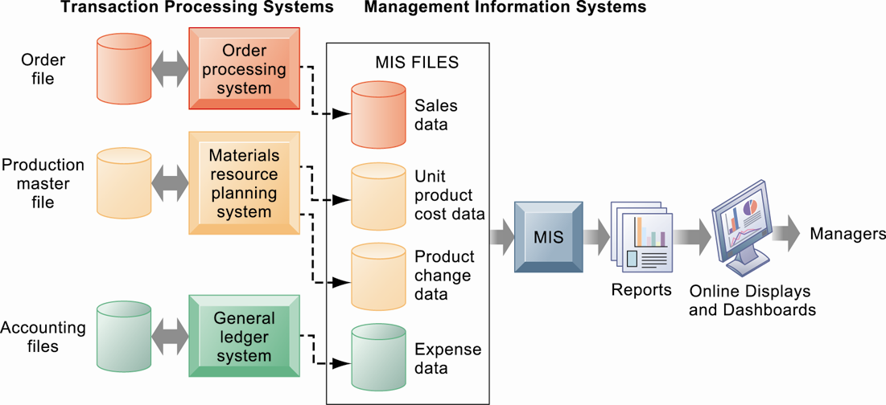
Essentials of Management Information Systems
Chapter 2 Global E-Business and Collaboration
How do systems serve managers and and improve organizational performance?
How MIS Obtain Their Data from TPS
Figure 2.6
Notes:
In the system illustrated by this diagram, three TPS supply summarized transaction data to the MIS reporting system at the end of the time period. Managers gain access to the organizational data through the MIS, which provides them with the appropriate reports.

Slide 24
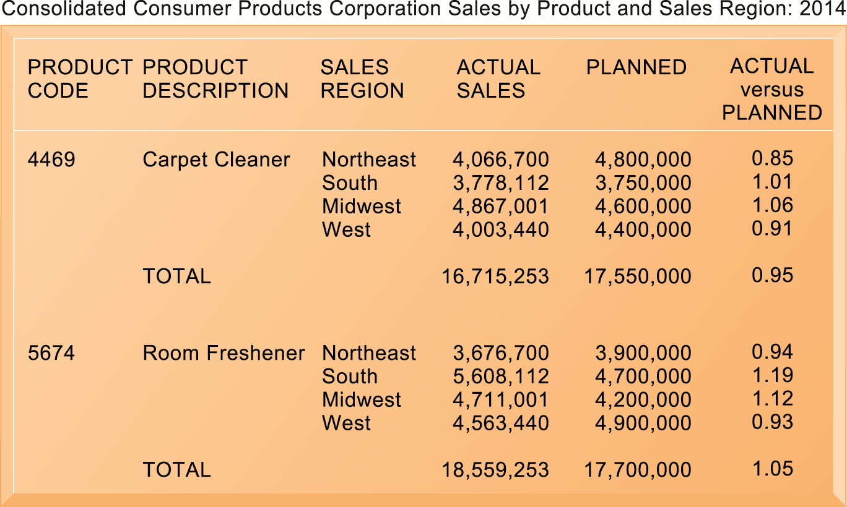
Essentials of Management Information Systems
Chapter 2 Global E-Business and Collaboration
How do systems serve managers and and improve organizational performance?
Sample MIS Report
This report, showing summarized annual sales data, was produced by the MIS in Figure 2-6.
Figure 2.7
Notes:
MIS reports are intended to summarize performance of the firm at a fairly concrete, product by product, region by region level. Typically, they report performance against planned objectives, e.g., planned sales of carpet cleaner $4.8 million in the quarter, actual sales were 4 million. This disparity should alert a manager to find out why the sales shortfall occurred.
Today, MIS reports to middle management are increasingly delivered not as paper reports but online summaries of operations. Increasingly, these internal reports are available on mobile platforms like smartphones.

Slide 25
Essentials of Management Information Systems
Chapter 2 Global E-Business and Collaboration
How do systems serve managers and and improve organizational performance?
Decision support systems (DSS):
  Serve middle managers.
  Support nonroutine decision making
    Example: What is impact on production schedule if December sales doubled?
  Often use external information as well from TPS and MIS
  Model driven DSS
    Voyage-estimating systems
  Data driven DSS
    Intrawest’s marketing analysis systems

Slide 26
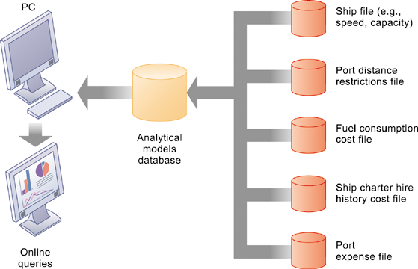
Essentials of Management Information Systems
Chapter 2 Global E-Business and Collaboration
How do systems serve managers and and improve organizational performance?
Voyage-Estimating Decision Support System
This DSS operates on a powerful PC. It is used daily by managers who must develop bids on shipping contracts.
Figure 2.8
Notes:
DSS are usually aimed at solving a recurring, very specific problem, like in this illustration calculating the costs of ocean transportation for a firm based on a variety of factors.

Slide 27
Essentials of Management Information Systems
Chapter 2 Global E-Business and Collaboration
How do systems serve managers and and improve organizational performance?
Executive support systems (ESS):
  Serve senior managers.
  Address strategic issues and long-term trends.
    E.g., what products should we make in five years?
  Address nonroutine decision making.
  Provide generalized computing capacity that can be applied to changing array of problems.
  Draw summarized information from MIS, DSS, and data from external events.
  Typically use portal with Web interface, or digital dashboard, to present content
Notes:
ESS are high level systems aimed at senior managers that summarize the performance of the firm along key dimensions, e.g., sales by region, product sales, cost of goods used in production, and weekly summaries of financial data. Usually this data is presented in an attractive “digital dashboard” interface.

Slide 28
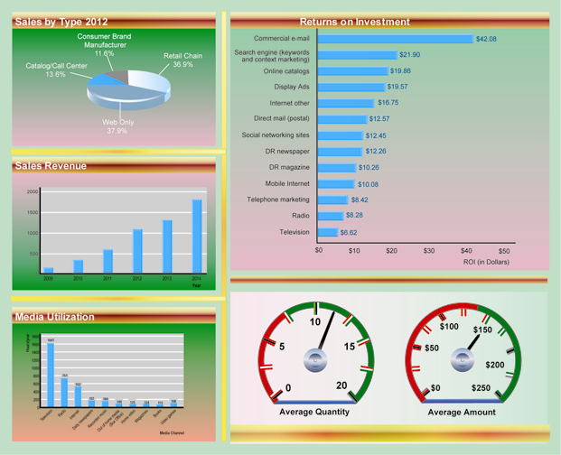
Essentials of Management Information Systems
Chapter 2 Global E-Business and Collaboration
How do systems serve managers and and improve organizational performance?
Digital Dashboard
A digital dashboard
delivers comprehensive
and accurate information
for decision making
often using a single
screen. The graphical
overview of key performance
indicators helps
managers quickly
spot areas that need
attention.
Notes:
Why is it that digital dashboards are more effective than, say, spreadsheets with rows and columns of the same data? One answer is just the cognitive cost of looking for “information” in table of rows and columns is much greater than looking at a graphical representation of the same data.

Slide 29
Essentials of Management Information Systems
Chapter 2 Global E-Business and Collaboration
How do systems serve managers and and improve organizational performance?
Interactive Session: Technology
Schiphol International Hub to Become Faultless… Truth or Dare?
How many levels of complexity can you identify in Schiphol’s baggage conveyor network?
What are the management, organization, and technology components of baggage handling systems?
Think of the data that the network uses. What kinds of management reports can be generated from that data?
Notes:
Ask students if they what entertainment or sports experiences they have had that have been enhanced in some way by information technology or services. Have the additional services been a benefit to their experience?

Slide 30
Essentials of Management Information Systems
Chapter 2 Global E-Business and Collaboration
How do systems serve managers and and improve organizational performance?
Systems for Linking the Enterprise
Enterprise applications
  Systems that span functional areas, focus on executing business processes across the firm, and include all levels of management
  Four major types
    Enterprise systems
    Supply chain management systems
    Customer relationship management systems
    Knowledge management systems
Notes:
ERP systems integrate business processes in manufacturing and production, finance and accounting, sales and marketing, and human resources into a single software system.
SCM systems help businesses manage relationships with their suppliers.
CRM systems help businesses manage relationships with their customers
KMS systems enable organizations to better manage processes for capturing and applying knowledge and expertise.

Slide 31
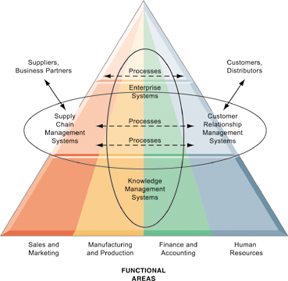
Essentials of Management Information Systems
Chapter 2 Global E-Business and Collaboration
How do systems serve managers and and improve organizational performance?
Enterprise Application Architecture
Enterprise applications automate processes that span multiple business functions and organizational levels and may extend outside the organization.
Figure 2.9
Notes:
Enterprise systems span functions, and span levels in the firm. This looks like a complicated diagram or concept, but the idea is simple: pull all the relevant information in a firm into a single database environment. Share it freely across all levels and specialties in the firm. In the past, where each silo of business had its own systems and databases, this was impossible. Whatever the marketing department “knew” was locked in marketing systems and databases which could not be access by managers in other departments.

Slide 32
Essentials of Management Information Systems
Chapter 2 Global E-Business and Collaboration
How do systems serve managers and and improve organizational performance?
Enterprise Systems
Also called enterprise resource planning (ERP) systems
Integrate data from key business processes into single system.
Speed communication of information throughout firm.
Enable greater flexibility in responding to customer requests, greater accuracy in order fulfillment.
Enable managers to assemble overall view of operations.
Notes:
The alternative to enterprise systems is departmental systems. What’s wrong with each department, say marketing and accounting, having their own systems to serve their needs?

Slide 33
Essentials of Management Information Systems
Chapter 2 Global E-Business and Collaboration
How do systems serve managers and and improve organizational performance?
Supply Chain Management (SCM) Systems
Manage relationships with suppliers, purchasing firms, distributors, and logistics companies.
Manage shared information about orders, production, inventory levels, and so on.
  Goal is to move correct amount of product from source to point of consumption as quickly as possible and at lowest cost
Type of interorganizational system:
  Automating flow of information across organizational boundaries
Notes:
Do students have any examples of supply chains based on their work experience? What are some of the difficulties they encountered? Some likely candidates are slow delivery, mistakes in delivery, inability to supply because of lack of inventory, delivery to wrong location, and so forth.

Slide 34
Essentials of Management Information Systems
Chapter 2 Global E-Business and Collaboration
How do systems serve managers and and improve organizational performance?
Customer Relationship Management (CRM) Systems
Help manage relationship with customers.
Coordinate business processes that deal with customers in sales, marketing, and customer service
Goals:
  Optimize revenue
  Improve customer satisfaction
  Increase customer retention
  Identify and retain most profitable customers
  Increase sales
Notes:
Have students interacted with a CRM? Most have but don’t realize it. Most everyone has interacted with a call center over the phone. What has been the experience of your students dealing with call centers? Why do they think call centers are important to a business? What’s the worst experience they have had? Often it’s a cable company or other utility. Or a bad experience with a foreign-based call center where customer services reps could not be easily understood. Why can service at call centers be so poor?

Slide 35
Essentials of Management Information Systems
Chapter 2 Global E-Business and Collaboration
How do systems serve managers and and improve organizational performance?
Knowledge Management Systems
Manage processes for capturing and applying knowledge and expertise
Collect relevant knowledge and make it available wherever needed in the enterprise to improve business processes and management decisions.
Link firm to external sources of knowledge
Notes:
Most students will never have heard of a “knowledge management system.” In one sense its just a corporate library which contains documents, even books, but also reports, PowerPoint slides, spreadsheets, in short, a collection of everything a firm (the people in it) knows about the business. Everyone knows (or did know) what a library is. Another way to think about knowledge management is to think about Google being a collection of part of what is known or thought to be in the world. A good knowledge management system would allow employees to search a corporate database just like searching Google.

Slide 36
Essentials of Management Information Systems
Chapter 2 Global E-Business and Collaboration
How do systems serve managers and and improve organizational performance?
Intranets and Extranets
Technology platforms that increase integration and expedite the flow of information
  Intranets:
    Internal networks based on Internet standards
    Often are private access area in company’s Web site
  Extranets:
    Company Web sites accessible only to authorized vendors and suppliers
    Facilitate collaboration
Notes:
The distinction between intranets and extranets is still common. Yet many companies simply talk about their “Web site” and the various areas of their Web site where access is confined to specific groups. Restricted areas of their Web sites are available only to employees (intranets). Other areas are open to outside suppliers, or customers (extranets). The important point is that no matter how you refer to the phenomenon, firms use their Web sites (many firms have multiple Web sites—some for strictly internal use, and some for use by outside parties) to deliver services and information to all the parties in their business value system, from suppliers to consumers.

Slide 37
Essentials of Management Information Systems
Chapter 2 Global E-Business and Collaboration
How do systems serve managers and and improve organizational performance?
E-Business, E-Commerce, and E-Government
E-business:
  Use of digital technology and Internet to drive major business processes
E-commerce:
  Subset of e-business
  Buying and selling goods and services through Internet
E-government:
  Using Internet technology to deliver information and services to citizens, employees, and businesses

Slide 38
Essentials of Management Information Systems
Chapter 2 Global E-Business and Collaboration
Why are systems for collaboration and social business so important and what
technologies do they use?
What Is Collaboration?
Growing importance of collaboration:
  Changing nature of work
  Growth of professional work
  Changing organization of the firm
  Changing scope of the firm
  Emphasis on innovation
  Changing culture of work and business
Notes:
A number of factors are leading to a growing emphasis on collaboration in the firm. Work is changing, requiring more cooperation and coordination. Professions play a larger role in firms than before, and this often requires more consultation among experts than before. Organizations are flatter, with many more decisions made far down in the hierarchy. Organizations are more far flung around the globe, in multiple locations. There’s an emphasis on finding and sharing ideas which requires collaboration. Finally, what it means to be a “good” employee these days is in part an ability to work with others, and collaborate effectively. The culture of work has changed.

Slide 39
Essentials of Management Information Systems
Chapter 2 Global E-Business and Collaboration
Why are systems for collaboration and social business so important and what
technologies do they use?
What is Social Business?
Use of social networking platforms to engage employees, customers, suppliers
Conversations to strengthen bonds
Requires information transparency
Seen as way to drive operational efficiency, spur innovation, accelerate decision making
Notes:
Ask students if they if social platforms (Facebook, Twitter) have influenced their purchasing decisions. Have they ever had a conversation with a company employee about a product, and how did that influence their impressions of the company? How could social networks help a company spur innovation?

Slide 40
Essentials of Management Information Systems
Chapter 2 Global E-Business and Collaboration
Why are systems for collaboration and social business so important and what
technologies do they use?
Business Benefits of Collaboration and Social Business
Investment in collaboration technology can return large rewards, especially in sales and marketing, research and development
Productivity: Sharing knowledge and resolving problems
Quality: Faster resolution of quality issues
Innovation: More ideas for products and services
Customer service: Complaints handled more rapidly
Financial performance: Generated by improvements in factors above
Notes:
Some of the benefits of collaboration and team work are greater productivity, faster reaction to market events, more innovation, and faster implementation times than previously without collaboration (command and control model). Ask students about their experience on the job with collaboration and team work. Have any worked in a more traditional “command and control” business?

Slide 41
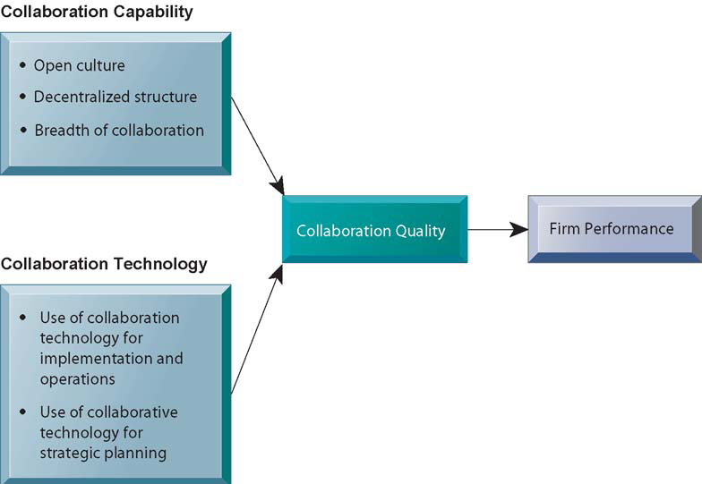
Essentials of Management Information Systems
Chapter 2 Global E-Business and Collaboration
Why are systems for collaboration and social business so important and what
technologies do they use?
Figure 2.10
Requirements for Collaboration
Successful collaboration
requires an appropriate
organizational structure
and culture, along with
appropriate collaboration
technology.
Notes:
The gist of modern literature on the firm is that firms which support collaboration, and actually do it, tend to perform better. Do students find this believable? What are some possible drawbacks to collaboration?

Slide 42
Essentials of Management Information Systems
Chapter 2 Global E-Business and Collaboration
Why are systems for collaboration and social business so important and what
technologies do they use?
Tools and Technologies for Collaboration and Teamwork
E-mail and instant messaging (IM)
Wikis
Virtual worlds
Collaboration and social business environments
  Virtual meeting systems (telepresence)
  Cloud collaboration services
    Google Drive, Dropbox
  Microsoft SharePoint and IBM Notes
  Enterprise social networking tools
Notes:
There’s been an explosion in collaboration tools and environments. Businesses are just now learning how to use them. Ask students how collaboration and teamwork are accomplished in their firms?

Slide 43
Essentials of Management Information Systems
Chapter 2 Global E-Business and Collaboration
Why are systems for collaboration and social business so important and what
technologies do they use?
Evaluating and Selecting Collaboration Software Tools
What are your firm’s collaboration challenges?
What kinds of solutions are available?
Analyze available products’ cost and benefits.
Evaluate security risks.
Consult users for implementation and training issues.
Select candidate tools and evaluate vendors.
Notes:
The basic idea here is to identify the kind of problem you have and adopt those technologies that make sense. The key problems are time and location. Generally, no one has enough time and often key people are not in the right place. How to overcome these challenges in a cost effective manner is the difficult part.

Slide 44
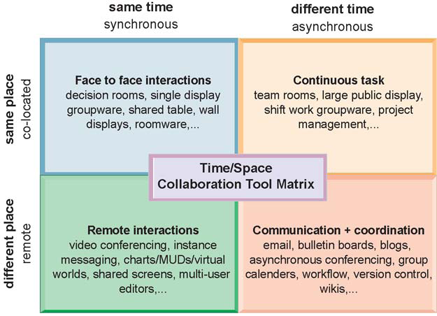
Essentials of Management Information Systems
Chapter 2 Global E-Business and Collaboration
Why are systems for collaboration and social business so important and what
technologies do they use?
The Time/Space
Collaboration Tool
Matrix
Collaboration technologies
can be classified in
terms of whether they
support interactions at
the same or different
time or place, and
whether these interactions
are remote or colocated.
Figure 2.11
Notes:
You can use this matrix to identify solutions to the time/location issues that face a firm, and to choose specific collaboration technologies.

Slide 45
Essentials of Management Information Systems
Chapter 2 Global E-Business and Collaboration
Is Social Business Working Out?
Interactive Session: People
Is Social Business Working Out?
Read the Interactive Session and then discuss the following questions:
Identify the people, organization, and technology factors responsible for impeding adoption of internal corporate social networks.
Compare the experiences implementing internal social networks of the two organizations. Why was one more successful than the other? What role did management play in this process?
Should all companies implement internal enterprise social networks? Why or why not?

Slide 46
Essentials of Management Information Systems
Chapter 2 Global E-Business and Collaboration
What is the role of the information systems function in a business?
The Information Systems Department
Programmers
Systems analysts
  Principle liaisons to rest of firm
Information systems managers
  Leaders of teams of programmers and analysts, project managers, physical facility managers, telecommunications managers, database specialists, managers of computer operations, and data entry staff
Senior managers: CIO, CPO, CSO, CKO
End users
Notes:
While in very small businesses the IS department is a single individual who does everything, as businesses get larger they generally develop a specialized unit, department, or division that handles all IS and IT areas in the firm. These IS units are composed of senior managers (CIO), middle managers, and technical employees like network administrators and computer programmers. End users are often represented on the governing bodies of these units as well, and consultants (external specialists) also can play a large role in IS departments by bringing in needed skills on an ad hoc basis.

Slide 47
Essentials of Management Information Systems
Chapter 2 Global E-Business and Collaboration
What is the role of the information systems function in a business?
Information Systems Services
  Computing services
  Telecommunications services
  Data management services
  Application software services
  Physical facilities management services
  IT management services
  IT standards services
  IT educational services
  IT research and development services
Notes:
IS services departments deliver specialized services to most other units of the organization, as well as providing the overall computer infrastructure in a firm that serves everyone.

